Slide 1
GSoC 2016 Adaptive and Reactive Planning
Kentaro Wada
www.kentaro.wada@gmail.com

Slide 2
System Configuration
MoveIt!
Plan for goal with MoveIt!
Simulate robot and sensors with Gazebo.
Stop execution and replan.
With user input.
With force sensor input.
Planning
User
Controller
User Input
Plan for goal
Gazebo
Stop and replan
Force, Torque
Force Sensor
Joint Trajectory
Robot

Slide 3
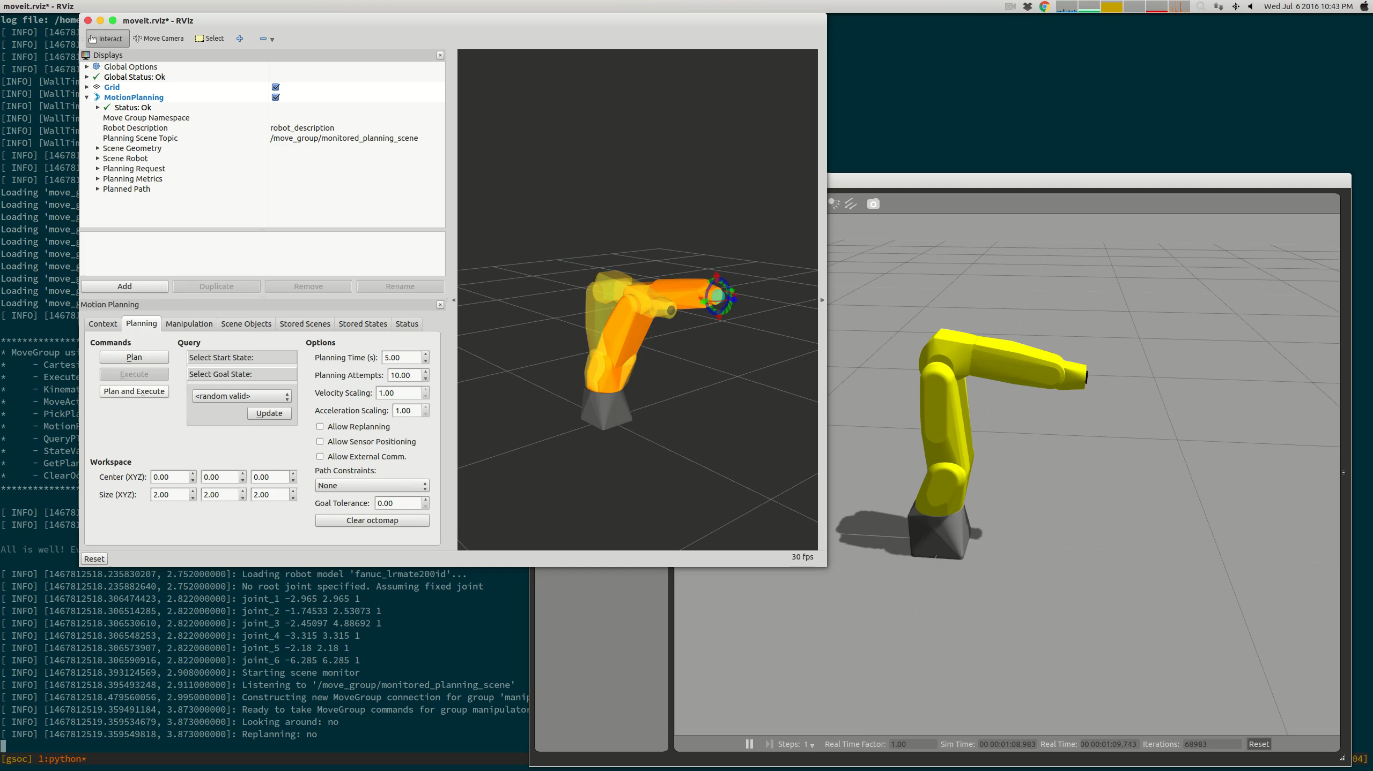
Planning with MoveIt
Control robot on Gazebo with MoveIt
Spawn robot model on Gazebo
https://github.com/ros-industrial/fanuc_experimental/pull/20
MoveIt config for robot on Gazebo
https://github.com/ros-industrial/fanuc_experimental/pull/21

Slide 4
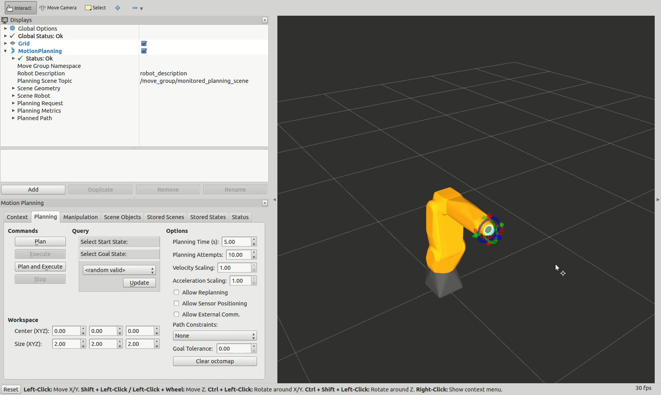
Stop planning execution with user input
Stop request from rviz plugin
https://github.com/ros-planning/moveit_ros/pull/709

Slide 5
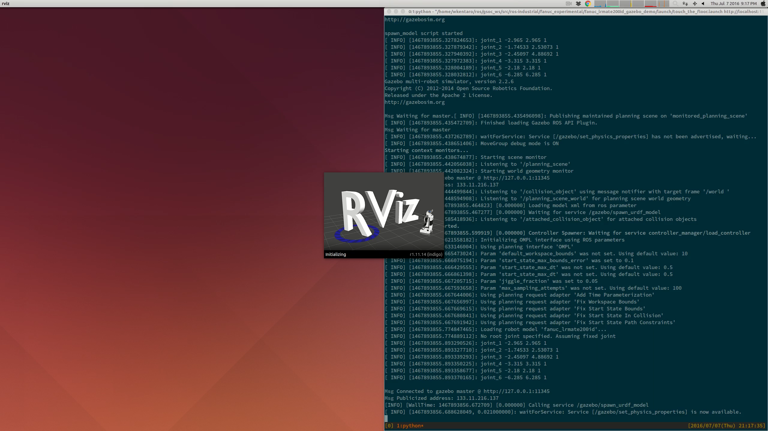
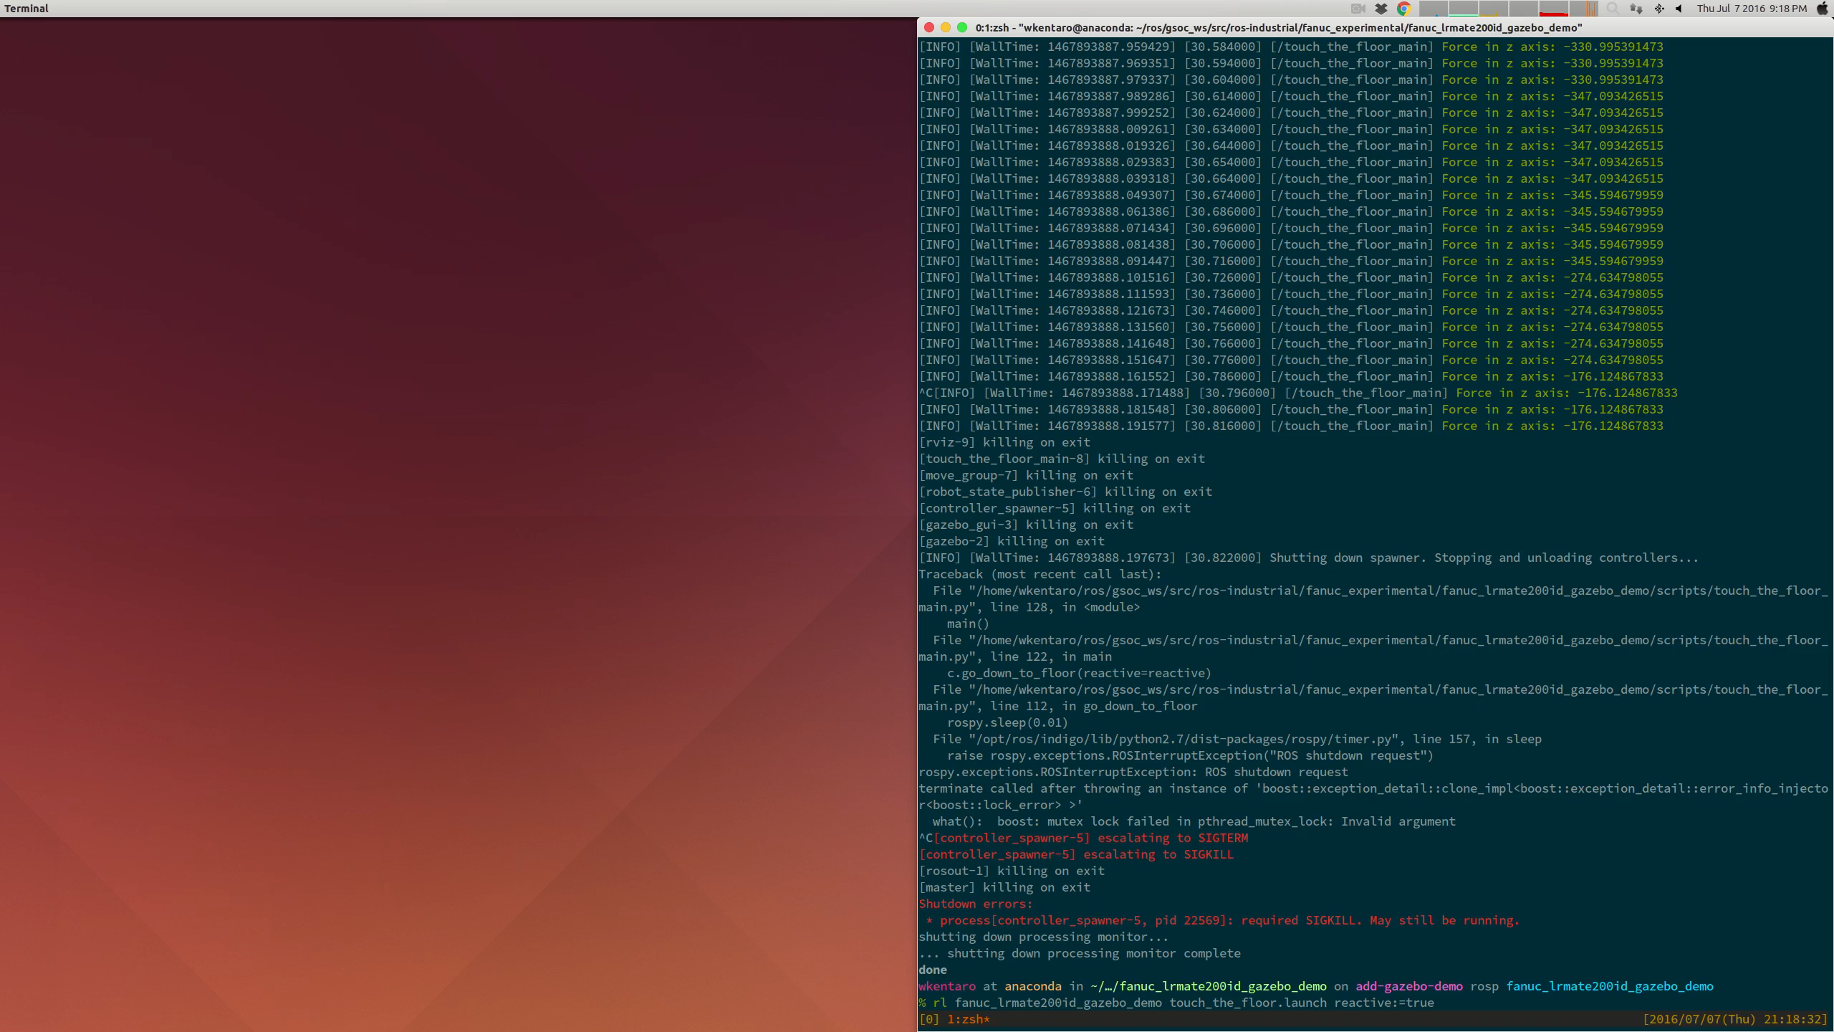
Stop planning execution with force sensor input
Reactive cancelling of planning execution
https://github.com/ros-industrial/fanuc_experimental/pull/23
Not Reactive:
Robot does not detect collision and breaks
Reactive:
Robot detects collision

Slide 6
Next Step
Replan by scene remembering
For replanning, remembering the scene is necessary.
Using MoveIt! scene or Octomap.
Demo of reactive planning with user input
Demo of reactive planning with pressure sensor
Possibly, picking task in environment with occlusions.

Slide 7
Todo
Reactive and Adaptive Path Planning Using Sensor Feedback and Operator Input
Sensor / operator input in real/simulated world
[x] Force sensor in real robot (Fanuc LR Mate 200iD)
[x] Installation & setup simulation.
[x] Implement force sensor plugin.
[x] Software for operator input.
Convert these input to be usable by planner
[x] Survey about existing planners and their acceptable inputs.
[x] Software for converting input for planner.
Re-planning while the execution of joint trajectory
[x] Survey about existing planners and ROS interface.
[ ] Software for re-planning.
Demonstration
[ ] Demo with simulation + force sensor
[ ] Demo with real robot + force sensor
[ ] Demo with simulation/real + visual sensor

